Slide 1
Android Application to Detect Plant Disease and Pest
Developed By
Name : Israk Ahmed
Student ID : 2037820103
Course Code : CSE 3162
Course Title : Mobile Application Development Lab
Department : Computer Science & Engineering
Session : 2019-2020
TMSS Engineering College Affiliated with University of Rajshahi

Slide 2
Table of Contents
Introduction
Features
Project Structure
Technologies Used
System Requirements
User Guide
Visual Overview
Conclusion
Page 01 of 12

Slide 3
Introduction
The Plant Disease and Pest Detection Mobile Application is an user-friendly tool designed to help farmers, gardeners, and plant enthusiasts identify and diagnose plant diseases and pest quickly and accurately. Leveraging the power of machine learning and image processing, the application analyzes images of plant leaves captured through the device's camera or uploaded from the gallery.
Page 02 of 12

Slide 4
Features
Image Capture
Image Upload
Real-Time Diagnosis
Disease Identification and Pest Detection
Educational Resources
User-Friendly Interface
Page 03 of 12

Slide 5
Project Structure
App Module
Manifest
Resource
Java
ML Model
Gradle Files
Page 04 of 12

Slide 6
Technologies Used
Java
XML
TensorFlow Lite
Android Studio
Page 05 of 12

Slide 7
System Requirements
Android OS version 6.0 (Marshmallow) and above.
Camera access permission for capturing images.
Internet connectivity for accessing additional resources and updates.
Page 06 of 12

Slide 8
User Guide (Steps)
Install and open the application on your android device.
Capture a new image using the device's camera or upload an image from the gallery.
Once the image is selected, the application will analyze it and provide a diagnosis of any detected plant diseases.
Users can explore additional information about the identified disease, including symptoms and treatment options.
Page 07 of 12

Slide 9
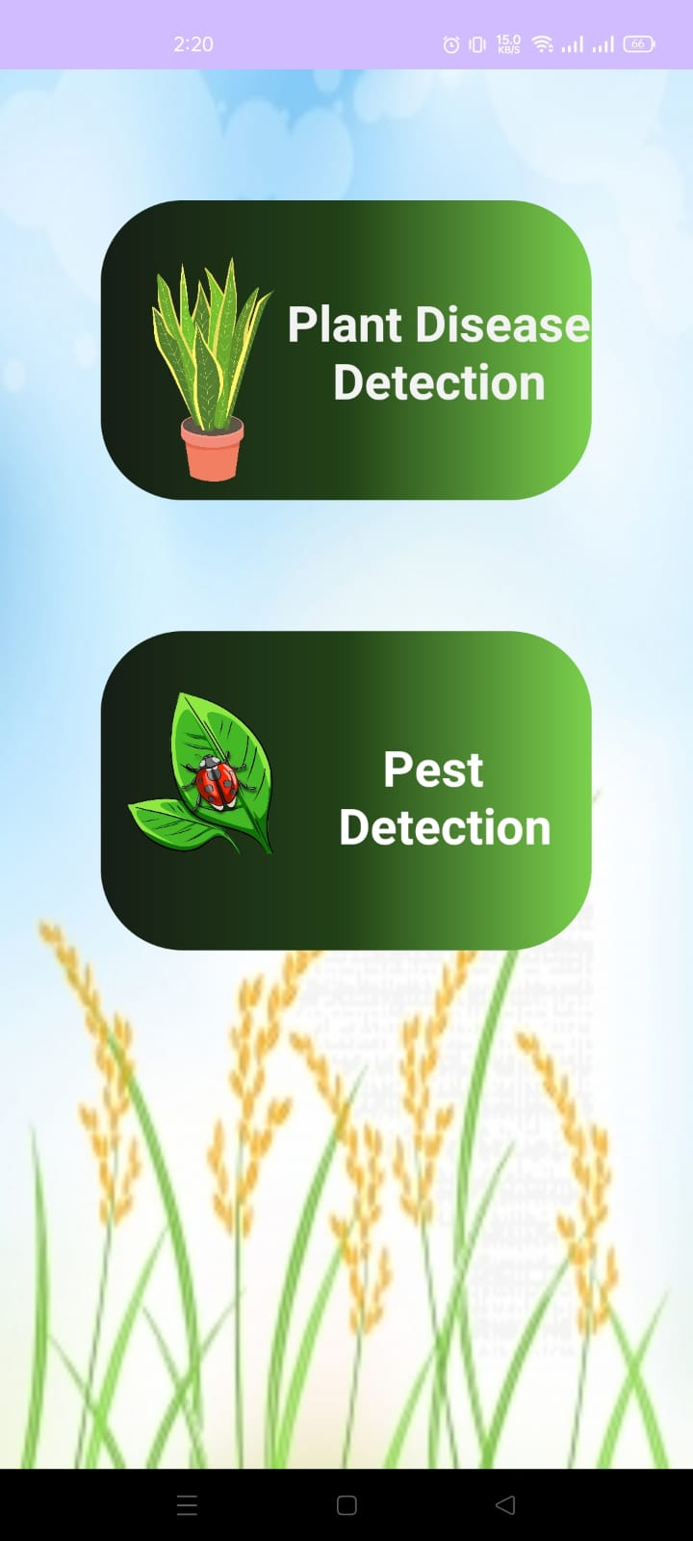
Visual Overview
Click here to detect plant disease
Home Page
Click here to detect pest
Page 08 of 12

Slide 10
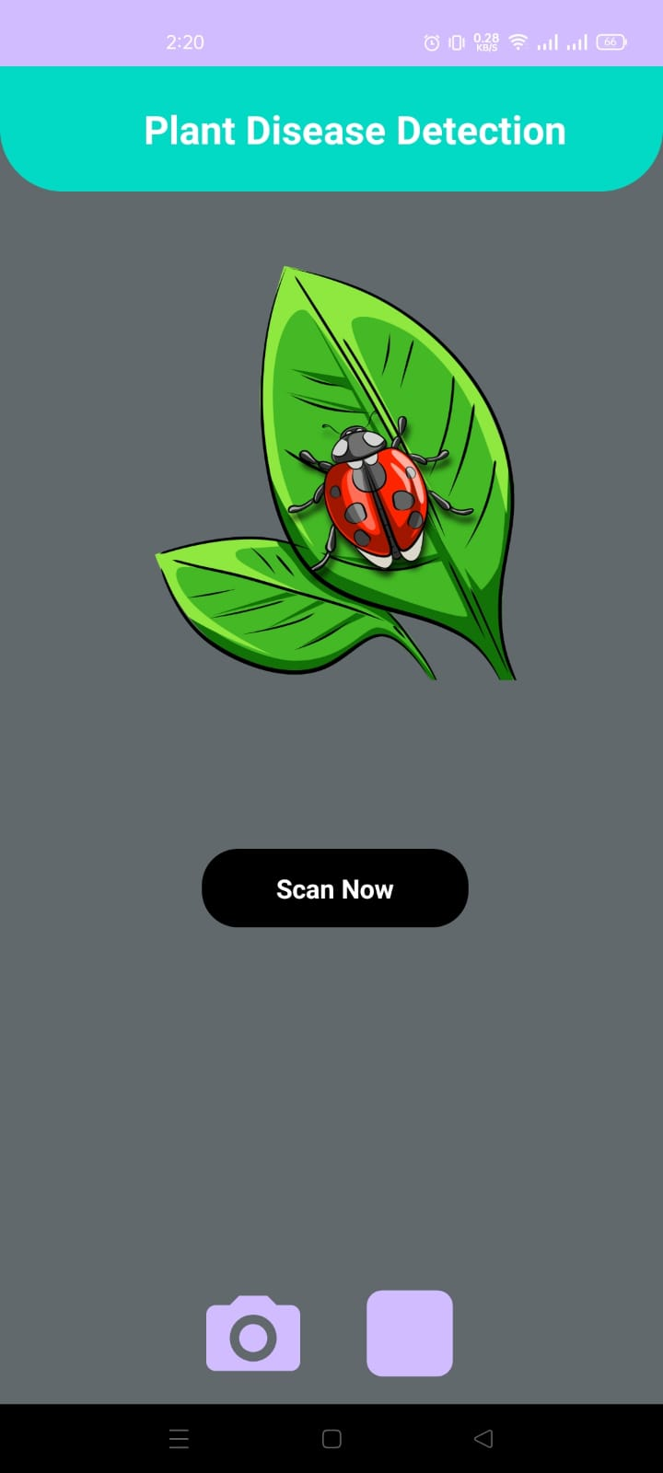
Visual Overview
Plant Disease Detection Page
Click here to capture image with camera
Click here to select image from gallery
Page 09 of 12

Slide 11
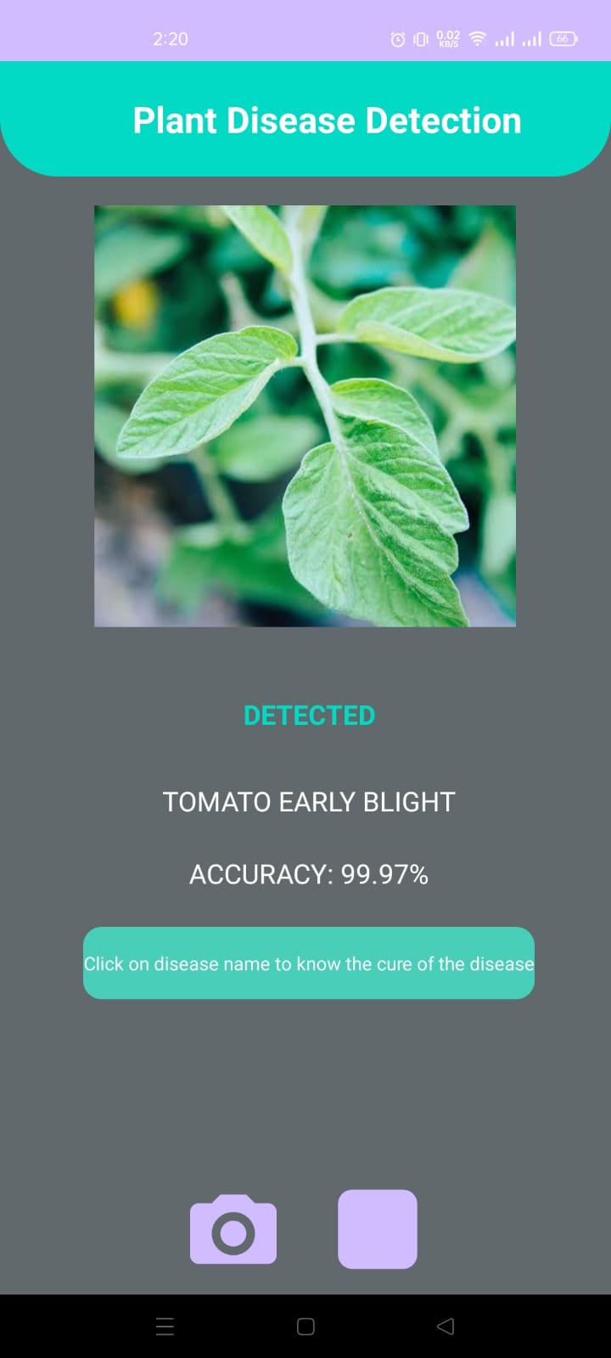
Visual Overview
Click here to get more information about the disease
Result Page
Click here to capture image with camera again
Click here to select image from gallery again
Page 10 of 12

Slide 12
Conclusion
The Plant Disease and Pest Detection Mobile Application serves as a valuable tool for plant enthusiasts and professionals alike, offering quick and accurate diagnosis of plant diseases. With its user-friendly interface and advanced features, the application aims to empower users to effectively manage plant health and contribute to improved crop yield and agricultural practices.
Page 11 of 12

Slide 13
ML Model Credit
Name : Anand Singh
GitHub : https://github.com/Anand-Singh-techie
Name : Saurabh Kumar
GitHub : https://github.com/indskgit
Page 12 of 12

Slide 14


Slide 15


